Slide 1



Sample from session for Maths Unit 2
Poisson Distribution and vectors

Slide 2
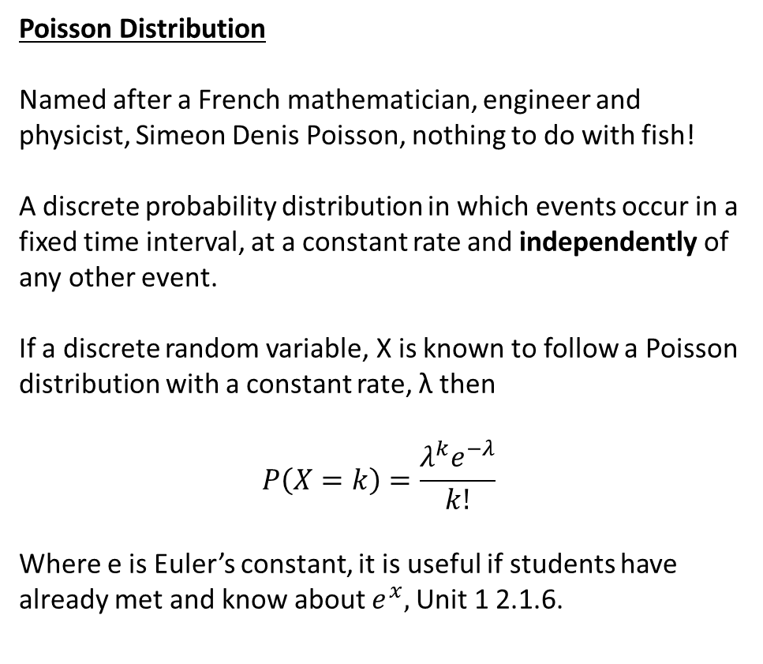
Poisson Distribution
Named after a French mathematician, engineer and physicist, Simeon Denis Poisson, nothing to do with fish!
A discrete probability distribution in which events occur in a fixed time interval, at a constant rate and independently of any other event.
If a discrete random variable, X is known to follow a Poisson distribution with a constant rate, λ then
$$P\left(X=k\right)=\frac{λ^{k}e^{−λ}}{k!}$$
Where e is Euler’s constant, it is useful if students have already met and know about $e^{x},$Unit 1 2.1.6.
It is important to note that for a Poisson distribution E(X)=Var(X)=λ.
Useful source of exam questions, WJEC S1 https://www.mathemateg.com/course/view.php?id=20
Students should experience using tables and a calculator to find relevant probabilities.
Link to digital copy of the statistical tables:
https://www.wjec.co.uk/qualifications/mathematics-a-as-level/?sub_nav_level=course-materials#tab_resources

Slide 3
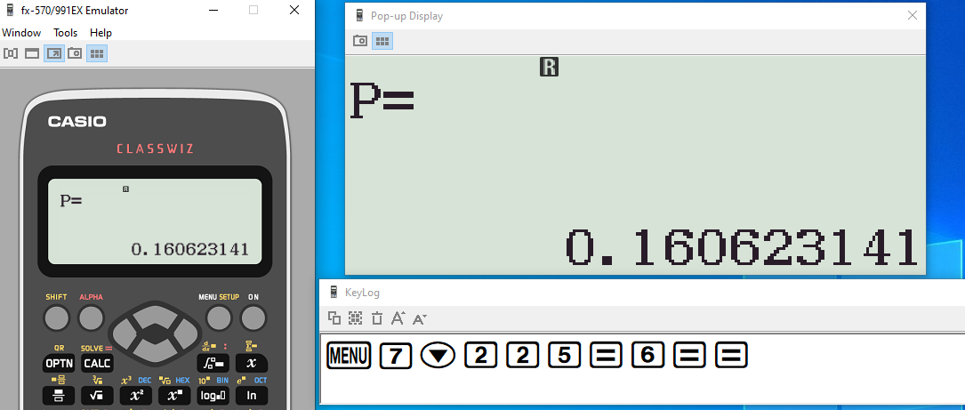

WJEC S1 2016 Q5
λ=0.2t, with t=30 minutes so λ=6 $X\sim Po\left(6\right)$
P(X=5)= $\frac{6^{5}e^{−6}}{5!}$
=0.160623141
=0.1606 (4dp)

Slide 4
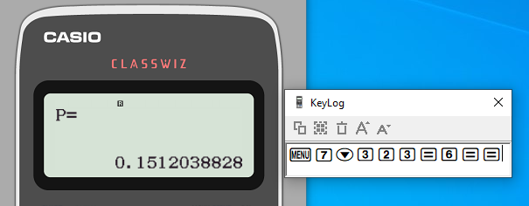
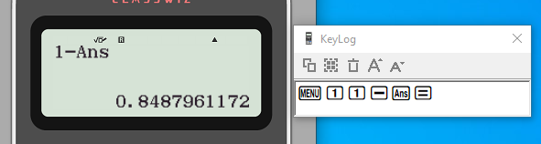

(ii) $P\left(X>3\right)=1−P\left(X≤3\right), λ=6$
$P\left(X≤3\right)=P\left(X=0\right)+P\left(X=1\right)+P(X=2)+P(X=3)$
$=\frac{e^{−6}6^{0}}{0!}+\frac{e^{−6}6^{1}}{1!}+\frac{e^{−6}6^{2}}{2!}+\frac{e^{−6}6^{3}}{3!}$
$=e^{−6}(1+6+18+36)$
=61$e^{−6}$
=0.1512038828
$$∴P\left(X>3\right)=0.8488 (4dp)$$

Slide 5
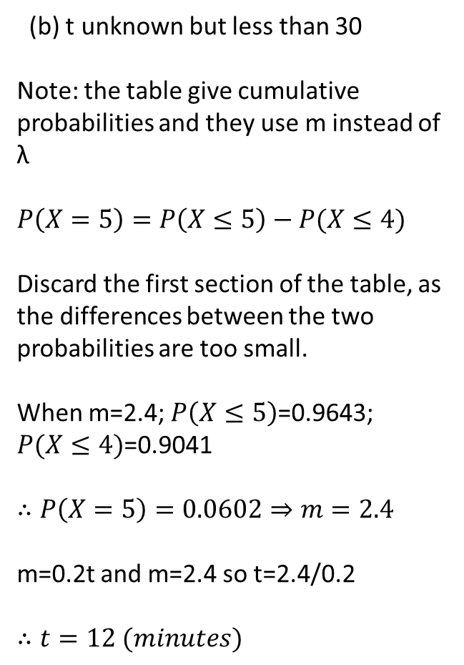
(b) t unknown but less than 30
Note: the table give cumulative probabilities and they use m instead of λ
$$P\left(X=5\right)=P\left(X≤5\right)−P(X≤4)$$
Discard the first section of the table, as the differences between the two probabilities are too small.
When m=2.4; $P\left(X≤5\right)$=0.9643; $P(X≤4)$=0.9041
$$∴P\left(X=5\right)=0.0602⇒m=2.4$$
m=0.2t and m=2.4 so t=2.4/0.2
$$∴t=12 (minutes)$$
Extract from WJEC Elementary Statistical tables

Slide 6
Newton’s second law and vectors (N2L)
Newton’s second (F=ma) is a simple enough three variable function which can clearly be used to establish the value of one variable providing the other two are known.
The issue with this topic is not the law as such, rather more that students have little or no experience in using vectors. GCSE Higher students might have used a translation vector and unit 1 will cover vectors (2.1.9) but as it is the last topic on the specification. Is it likely to be the last thing they meet?

Slide 7


WJEC 2019 AS Unit 2 Q6
Every mechanics question DAD (draw a diagram)
These three forces can be expressed as a single resultant force using simple vector addition.

Slide 8

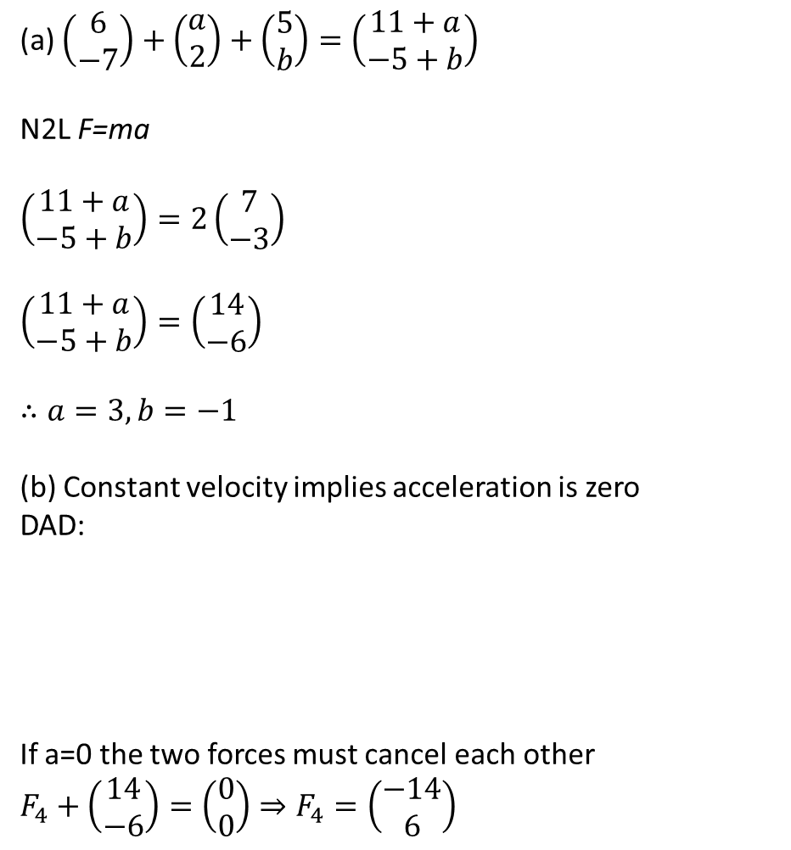

(a) $\left(\begin{matrix}6 \\ −7\end{matrix}\right)+\left(\begin{matrix}a \\ 2\end{matrix}\right)+\left(\begin{matrix}5 \\ b\end{matrix}\right)=\left(\begin{matrix}11+a \\ −5+b\end{matrix}\right)$
N2L F=ma
$$\left(\begin{matrix}11+a \\ −5+b\end{matrix}\right)=2\left(\begin{matrix}7 \\ −3\end{matrix}\right)$$
$$\left(\begin{matrix}11+a \\ −5+b\end{matrix}\right)=\left(\begin{matrix}14 \\ −6\end{matrix}\right)$$
$$∴a=3, b=−1$$
(b) Constant velocity implies acceleration is zero
DAD:
If a=0 the two forces must cancel each other
$$F_{4}+\left(\begin{matrix}14 \\ −6\end{matrix}\right)=\left(\begin{matrix}0 \\ 0\end{matrix}\right)⇒F_{4}=\left(\begin{matrix}−14 \\ 6\end{matrix}\right)$$

Slide 9
Sample from session for Maths Unit 2
Poisson Distribution and vectors

