Slide 1
Sample from Study Session 1
“2. Power”
FMSP Wales Professional Learning 2020
WJEC Further Maths Unit 3

Slide 2
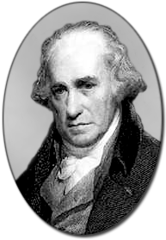
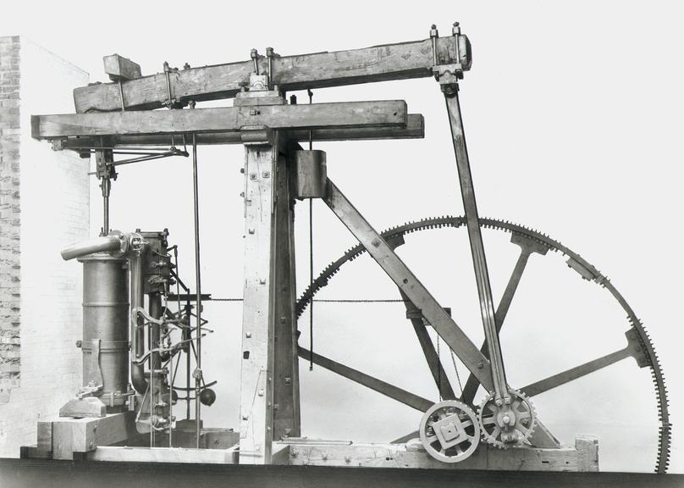
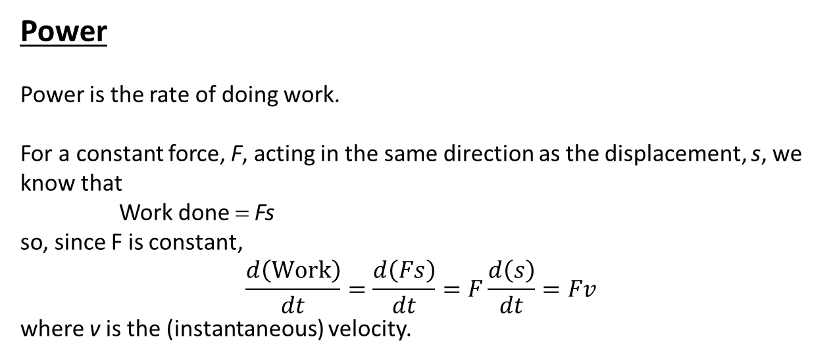
Power
Power is the rate of doing work.
For a constant force, F, acting in the same direction as the displacement, s, we know that
Work done = Fs
so, since F is constant,
$$\frac{d\left(Work\right)}{dt}=\frac{d\left(Fs\right)}{dt}=F\frac{d\left(s\right)}{dt}=Fv$$
where v is the (instantaneous) velocity.
$$P=Fv$$
The SI units of Power is Joules per second, also called Watts after the famous Scottish engineer James Watt whose improvements to early stationary steam engines were vital in developing practical machines which went on to power the industrial revolution.

Slide 3
For a non-constant force, F(x), acting in the same direction as the displacement, x, we know that
W= Work done in moving from x = 0 to x = s
is given by
$$W=\int_{0}^{s}{F\left(x\right) dx}$$
$$⇒ \frac{dW}{ds}=F\left(s\right)$$
Chain rule
$$P=Power=\frac{dW}{dt}=\frac{dW}{ds}\frac{ds}{dt}$$
$$⇒ P=F\left(s\right)\frac{ds}{dt}=F\left(s\right)v$$
Is applicable whenever the Force acts in the same direction as the motion.
$$P=Fv$$
In general, $P=\underline{F}•\underline{v}$

Slide 4
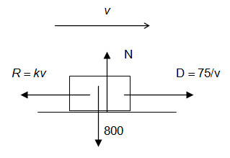
Example 1 : (Use g = 10 m/s² in this example)
A cyclist moves against a resistance which is proportional to his speed. At a power output of 75 W, he has a maximum speed of 5 m/s on level ground.
If the cyclist and bike together have a combined mass of 80 kg, find their maximum speed when travelling down a hill inclined at $\sin^{−1}\left(\frac{1}{40}\right)$ to the horizontal when the cyclist is working at a rate of 32 W.
Find the instantaneous acceleration of the cyclist if she is travelling at this speed and suddenly increases his power to 40 W.
a
At 5 ms⁻¹, the cyclist is travelling at maximum speed so her the acceleration will be zero.

Slide 5
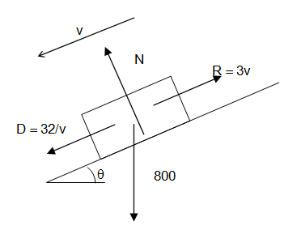
Example 1 : (Use g = 10 m/s² in this example)
A cyclist moves against a resistance which is proportional to his speed. At a power output of 75 W, he has a maximum speed of 5 m/s on level ground.
If the cyclist and bike together have a combined mass of 80 kg, find their maximum speed when travelling down a hill inclined at $\sin^{−1}\left(\frac{1}{40}\right)$ to the horizontal when the cyclist is working at a rate of
32 W.
Find the instantaneous acceleration of the cyclist if he is travelling at this speed and suddenly increases his power to 40 W.
Now considering the motion on the hill when
the power output of the cyclist is 32 W:
a

Slide 6
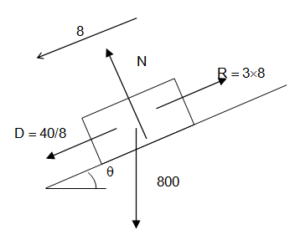
Example 1 : (Use g = 10 m/s² in this example)
A cyclist moves against a resistance which is proportional to his speed. At a power output of 75 W, he has a maximum speed of 5 m/s on level ground.
If the cyclist and bike together have a combined mass of 80 kg, find their maximum speed when travelling down a hill inclined at $\sin^{−1}\left(\frac{1}{40}\right)$ to the horizontal when the cyclist is working at a rate of 32 W.
Find the instantaneous acceleration of the cyclist if he is travelling at this speed and suddenly increases his power to 40 W.
If the power is now suddenly increased to 40 W:
a

