Slide 1
Week 3
2 challenges to work through this week!
A look into one of the most fascinating triangles ever!
Followed by a classic type of puzzle with not much help! Sorry!
For the 6 live online talks – look out for the email! Coming soon!
3

Slide 2
Challenge 1: Pascal!
Imagine if you will…. A mathematical brick wall.
Each brick in the sum of the two bricks directly above it.
The blue brick is the sum of the two yellow bricks.
0
0
0
0
0
0
0
0
0
0
0
0
0
0
0
0
0
0
0
0
0
0
0
0
0
0
0
0
0
0
0
0
0
0
0
0
0
0
0
0
0
0
0
0
0
0
0
0
0
0
0
0
0
0
0
0
0
0
0
0
0
0
0
0
0
0
0
0
0
0
0
0
0

Slide 3
So, if we make a single brick on the top row, worth 1…
Click through to see how the wall changes…
0
0
0
0
1
0
0
0
0
0
0
0
0
0
0
0
0
0
0
0
0
0
0
0
0
0
0
0
0
0
0
0
0
0
0
0
0
0
0
0
0
0
0
0
0
0
0
0
0
0
0
0
0
0
0
0
0
0
0
0
0
0
0
0
0
0
0
0
0
0
0
0
0

Slide 4
0
0
0
0
1
0
0
0
0
0
0
0
0
0+1
1+0
0
0
0
0
0
0
0
0
0
0
0
0
0
0
0
0
0
0
0
0
0
0
0
0
0
0
0
0
0
0
0
0
0
0
0
0
0
0
0
0
0
0
0
0
0
0
0
0
0
0
0
0
0
0
0
0
0
0

Slide 5
0
0
0
0
1
0
0
0
0
0
0
0
0
1
1
0
0
0
0
0
0
0
0+1
1+1
1+0
0
0
0
0
0
0
0
0
0
0
0
0
0
0
0
0
0
0
0
0
0
0
0
0
0
0
0
0
0
0
0
0
0
0
0
0
0
0
0
0
0
0
0
0
0
0
0
0

Slide 6
0
0
0
0
1
0
0
0
0
0
0
0
0
1
1
0
0
0
0
0
0
0
1
2
1
0
0
0
0
0
0
0+1
1+2
2+1
1+0
0
0
0
0
0
0
0
0
0
0
0
0
0
0
0
0
0
0
0
0
0
0
0
0
0
0
0
0
0
0
0
0
0
0
0
0
0
0

Slide 7
0
0
0
0
1
0
0
0
0
0
0
0
0
1
1
0
0
0
0
0
0
0
1
2
1
0
0
0
0
0
0
1
3
3
1
0
0
0
0
0
0+1
1+3
3+3
3+1
1+0
0
0
0
0
0
0
0
0
0
0
0
0
0
0
0
0
0
0
0
0
0
0
0
0
0
0
0
0

Slide 8
0
0
0
0
1
0
0
0
0
0
0
0
0
1
1
0
0
0
0
0
0
0
1
2
1
0
0
0
0
0
0
1
3
3
1
0
0
0
0
0
1
4
6
4
1
0
0
0
0
0+1
1+4
4+6
6+4
4+1
1+0
0
0
0
0
0
0
0
0
0
0
0
0
0
0
0
0
0
0

Slide 9
0
0
0
0
1
0
0
0
0
0
0
0
0
1
1
0
0
0
0
0
0
0
1
2
1
0
0
0
0
0
0
1
3
3
1
0
0
0
0
0
1
4
6
4
1
0
0
0
0
1
5
10
10
5
1
0
0
0+1
1+5
5+10
10+10
10+5
5+1
1+0
0
0
0
0
0
0
0
0
0

Slide 10
0
0
0
0
1
0
0
0
0
0
0
0
0
1
1
0
0
0
0
0
0
0
1
2
1
0
0
0
0
0
0
1
3
3
1
0
0
0
0
0
1
4
6
4
1
0
0
0
0
1
5
10
10
5
1
0
0
1
6
15
20
15
6
1
0
0+1
1+6
6+15
15+20
20+15
15+6
6+1
1+0

Slide 11
Now if we remove the zero bricks, we can see a pretty cool pattern.
0
0
0
0
1
0
0
0
0
0
0
0
0
1
1
0
0
0
0
0
0
0
1
2
1
0
0
0
0
0
0
1
3
3
1
0
0
0
0
0
1
4
6
4
1
0
0
0
0
1
5
10
10
5
1
0
0
1
6
15
20
15
6
1
0
1
7
21
35
35
21
7
1

Slide 12
The triangle is called Pascal’s Triangle.
It contains a wealth of mathematical wonders! You could, of course, continue and make the triangle contain as many rows as you like.
1
1
1
1
2
1
1
3
3
1
1
4
6
4
1
1
5
10
10
5
1
1
6
15
20
15
6
1
1
7
21
35
35
21
7
1

Slide 13
Let us have a look at some of the wonders which are hidden within…
1
1
1
1
2
1
1
3
3
1
1
4
6
4
1
1
5
10
10
5
1
1
6
15
20
15
6
1
1
7
21
35
35
21
7
1

Slide 14
Always 1s down both sides.
1
1
1
1
2
1
1
3
3
1
1
4
6
4
1
1
5
10
10
5
1
1
6
15
20
15
6
1
1
7
21
35
35
21
7
1

Slide 15
And the Natural numbers (counting numbers) are on the second diagonal.
1
1
1
1
2
1
1
3
3
1
1
4
6
4
1
1
5
10
10
5
1
1
6
15
20
15
6
1
1
7
21
35
35
21
7
1

Slide 16
Had you noticed it’s symmetrical?
That’s right, every pattern will be there twice!
1
1
1
1
2
1
1
3
3
1
1
4
6
4
1
1
5
10
10
5
1
1
6
15
20
15
6
1
1
7
21
35
35
21
7
1

Slide 17
On the third diagonal we have the Triangular numbers.
Triangular numbers are like square numbers, but rather than making squares, they make triangles…
1
1
1
1
2
1
1
3
3
1
1
3
6
10
1
4
6
4
1
1
5
10
10
5
1
1
6
15
20
15
6
1
1
7
21
35
35
21
7
1
Using Pascal’s triangle or otherwise, explain in words the term-to-term rule for triangular numbers?
What would be the term-to-term rule for square numbers 1, 4, 9, 16…?
Put answers on the Desmos activity (page 2) .

Slide 18
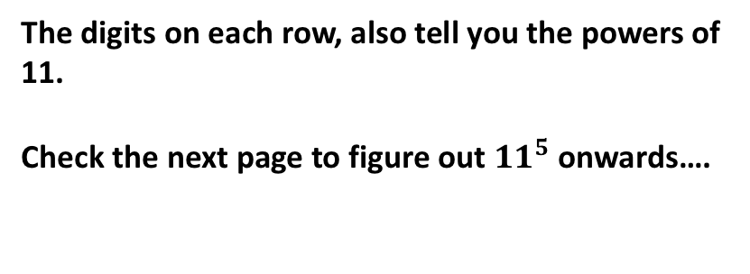
The digits on each row, also tell you the powers of 11.
Check the next page to figure out ${11}^{5}$ onwards….
1
$$1={11}^{0}$$
1
1
$$11={11}^{1}$$
1
2
1
$$121={11}^{2}$$
1
3
3
1
$$1331={11}^{3}$$
1
4
6
4
1
$$14641={11}^{4}$$
1
5
10
10
5
1
$$161051={11}^{5}$$
1
6
15
20
15
6
1
$$1771561={11}^{6}$$
1
7
21
35
35
21
7
1
$$19487171={11}^{7}$$

Slide 19
100
20
+ 1
121
1000
300
30
+ 1
1331
10000
4000
600
40
+ 1
14641
100000
50000
10000
1000
50
+ 1
161051
1
$$1={11}^{0}$$
1
1
$$11={11}^{1}$$
1
2
1
$$121={11}^{2}$$
1
3
3
1
$$1331={11}^{3}$$
1
4
6
4
1
$$14641={11}^{4}$$
1
5
10
10
5
1
$$161051={11}^{5}$$
1
6
15
20
15
6
1
$$1771561={11}^{6}$$
1
7
21
35
35
21
7
1
$$19487171={11}^{7}$$
Show the column additional from Pascal’s triangle that gives you ${11}^{7}$. Check it works!
Put your answer on the Desmos activity (page 3) .

Slide 20
The sum of the digits on each row, give you the powers of 2.
1
$$1=2^{0}$$
1
1
$$1+1=2^{1}$$
1
2
1
$$1+2+1=2^{2}$$
1
3
3
1
$$1+3+3+1=2^{3}$$
1
4
6
4
1
$$1+4+6+4+1=2^{4}$$
1
5
10
10
5
1
$$1+5+10…+1=2^{5}$$
1
6
15
20
15
6
1
$$1+6+15…+1=2^{6}$$
1
7
21
35
35
21
7
1
$$1+7+21…+1=2^{7}$$
Draw, sketch, doodle or type something to show that the next row down 1,8… gives a total which is $2^{8}$
Put your answer on the Desmos activity (page 4) .

Slide 21
There are a few more patterns and useful things to find, but that’s probably enough for now.
Ok! One last one… I’ll leave you to find it.
If you pick any one of the counting numbers… By looking around it, how can you find out the square of that number?
1
1
1
1
2
1
E.g If I picked 3…. How can I find out what $3^{2}$is using the triangle?
1
3
3
1
1
4
6
4
1
Put your answer on the Desmos activity (page 5) .
1
5
10
10
5
1
1
6
15
20
15
6
1
1
7
21
35
35
21
7
1

Slide 22
Challenge 1: Pascal!
Surely, the triangle doesn’t help with algebra?
Let’s try expanding some brackets.
$${(x+y)}^{0}$$
$$=1$$
$$=1$$
$$1y^{0}$$
$$1x^{0}$$
$$1$$
$$1$$
$${(x+y)}^{1}$$
$$=x+y$$
$$=(x+y)$$
$$1xy^{0}+1y^{1}$$
$$1x^{1}+1x^{0}y$$
$$1x+1y$$
$$x+y$$
$${(x+y)}^{2}$$
$$=x^{2}+2xy+y^{2}$$
$=(x+y)$ $(x+y)$
$${1x}^{2}y^{0}+2xy^{1}+1y^{2}$$
$$1x^{2}+2x^{1}y+{1x^{0}y}^{2}$$
$${1x}^{2}+2xy+{1y}^{2}$$
$$x^{2}+2xy+y^{2}$$
$${(x+y)}^{3}$$
$$=x^{3}+3x^{2}y+3{xy}^{2}+y^{3}$$
$=(x+y)$ $(x+y)$ $(x+y)$ $(x+y)$
$${1x}^{3}y^{0}+3x^{2}y^{1}+3xy^{2}+1y^{3}$$
$$1x^{3}+3x^{2}y+3{x^{1}y}^{2}+{1x^{0}y}^{3}$$
$${1x}^{3}+3x^{2}y+3{xy}^{2}+{1y}^{3}$$
$$x^{3}+3x^{2}y+3{xy}^{2}+y^{3}$$
Ok, not too bad.
Let’s put these answers in a pile!
Oooo…. The coefficients.
hmmm…. The powers of x. and $y$!
hmmm…. The powers of $x$.
1
$$1$$
1
1
$$1x+1y$$
1
2
1
$${1x}^{2}+2xy+{1y}^{2}$$
1
3
3
1
$${1x}^{3}+3x^{2}y+3{xy}^{2}+{1y}^{3}$$
1
4
6
4
1
$$????$$
Using the patterns above….
Reckon you can figure out ${(x+y)}^{4}$..without expanding all the brackets?
What about ${(x+y)}^{6}$? Make sure you use the correct row of the triangle, the top row remember is a power of 0.
Put your answers on the Desmos activity (page 6) .

Slide 23
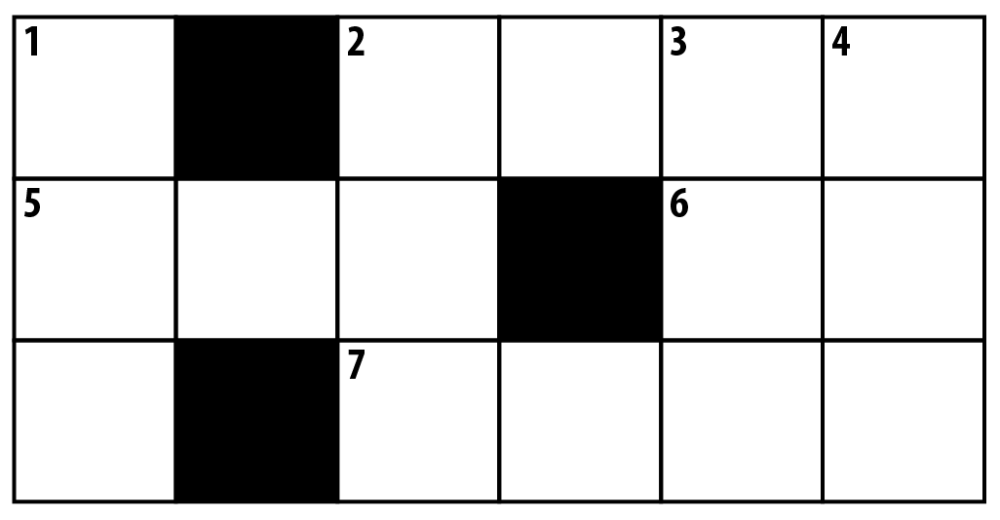
Challenge 2: Crossnumber
A crossnumber works like a crossword, only with numbers!
However, I’m not giving you the clues!
Across | Down
2) | 1)
5) | 2)
6) | 3)
7) | 4)
The only help I’m giving you is that the answers include:
two square numbers,
one cube, one fifth power, one sixth power, one seventh power, one ninth power and one twelfth power!
Some extra hints on the Desmos activity if you need ☺
Put your answer on the Desmos activity (page 7) .

